Slide 1
CSSE 332 Signals
Note: we'll be doing a code activity in class today, so get your Linux install
booted up and cd to today's class materials.

Slide 2
Outline
Why do we need signal?
What is signal?
How to use it in a program?
What to expect if using signal?

Slide 3
Motivation
Other processes want to “inform” to OS of something
Interrupt, needs hardware support
OS wants to “interfere” other processes
E.G.,

Slide 4

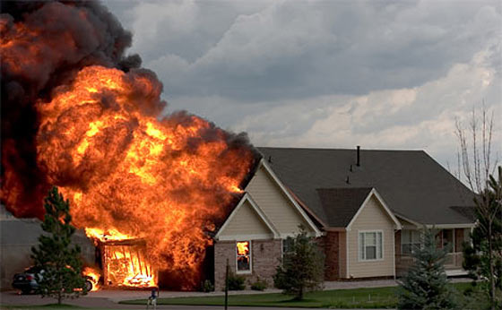
What is Signal?
A mechanism for the OS to send important "alerts" to a running process, in a way that can disrupt normal execution
Other process is trying to kill/reboot your process/computer
Illegal operation
Control-C at the command line

Slide 5
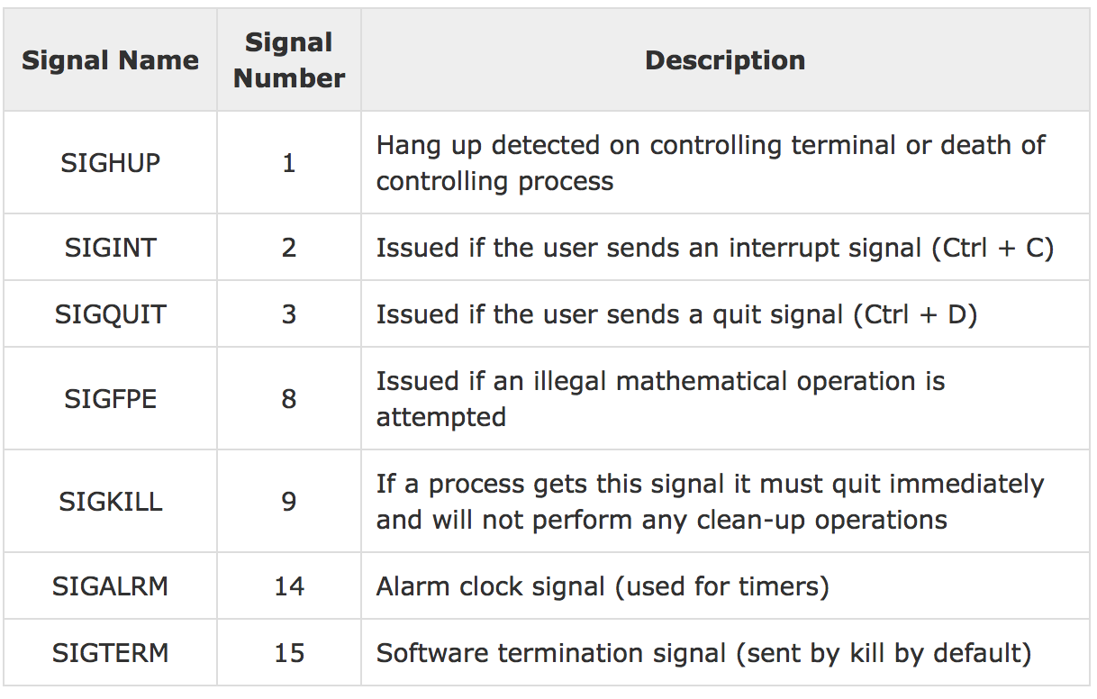
What to do when receive signal?
By default, most signals kill your process
But if you want you can override the default behavior and set a function pointer to handle the signal:
signal(SIGINT, my_cool_handler_func_ptr);

Slide 6

Handlers
A signal handler is a “forced ” function call whenever you receive that signal.
You can execute your code in the handler.
If you should return from your signal handler, execution continues from wherever you left.

Slide 7
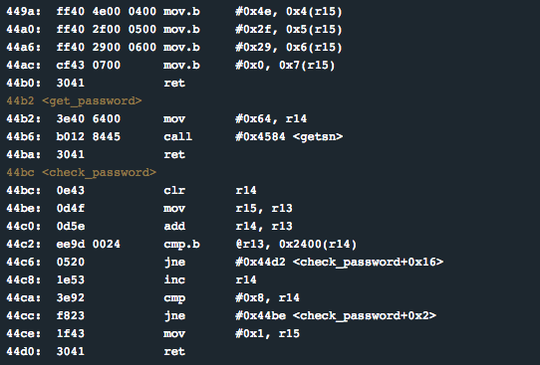

Order of events
1. Something
happens at the device
2. Device raises
an interrupt
3. CPU finishes the last assembly instruction
Time to handle the issue at hand

Slide 8


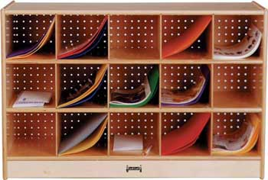
Order of events
4. Save the current state
Registers, stack, instruction
pointer, CCR, etc.
5. OS Exception Handler
Figure out what happened
6. Jump into the Interrupt Handler responsible for that

Slide 9
Practice by reviewing code
Just read the code (signal.c), don’t run it.
Write down the first 10 lines of screen output, if CTRL-C is pressed right after the child finishes the first iteration in the loop.

Slide 10
Problems of the “forced” jump
”Jump” at the wrong time.
Some library functions can’t handle interruptions.
So it is desirable to block certain signals – so called signal masks.

Slide 11
Each signal type is managed individually
// make a signal set that only contains SIGINT
sigset_t mask;
sigemptyset (&mask);
sigaddset (&mask, SIGINT);
//block that signal set
sigprocmask(SIG_BLOCK, &mask, NULL);

Slide 12
Activity
Look at the code in example1.c
Solve the activity (all the parts)

Slide 13
Signal Handler Notes
By default, a signal handler blocks signals of its own type
Only a short list¹ of functions are save in signal handler.
So many signal handler simply alert – set global alarm and let other process check for.
¹http://man7.org/linux/man-pages/man7/signal-safety.7.html

